Slide 1
CSP554 Big Data Technologies
Module 2b
Hadoop Distributed File System (HDFS)

Slide 2
Distributed File Systems
When a dataset outgrows the storage capacity of a single physical machine or storage device…
It becomes necessary to partition it across a number of separate machines or devices
File systems that manage storage across a network of machines are called distributed file systems
Since they are network based, all the complications of a cluster kicks in
So distributed file systems are more complex (subject to more failure modes) than centralized ones
The file system must tolerate node, storage and other failures without suffering data loss

Slide 3
HDFS
Hadoop comes with a standard distributed file system implementation
Hadoop Distributed File System
Provides scalable, fault-tolerant, rack-aware data storage
But Hadoop supports a general purpose file system abstraction (API)
Allows Hadoop to use other file system implementations
Examples
Amazon Web Services S3 Buckets
Microsoft Azure Blob Storage
Offers a range of powerful but nonstandard functionality

Slide 4
HDFS Characteristics
Designed for storing very large files reliably
Gigabytes to Terabytes in size
Provides those data sets at high bandwidth to distributed user applications
These capabilities both are achieved by replicating file contents on multiple machines
Optimized for write once, read many access pattern
No updates to already written data
But, appends to files are permitted
Useful for analysis of large and sometimes growing datasets of mostly unchanging records

Slide 5
HDFS Characteristics
Assumes use of commodity hardware (or cloud VMs) for which the chance of failure is (relatively) high
Designed to carry on working with no loss of data or interruption noticeable to the user in the face of such failures
High throughput (but also high latency) streaming data access
Applications requiring low latency (10ms) access to data will not work well with Hadoop
Applications that require high data read performance (throughput) are exactly those for which HDFS is optimized
In memory caching and other advanced techniques may offer improved latency over time

Slide 6
HDFS Characteristics
Offers good performance for a relatively small number of large files and not many small ones
File system metadata is stored in memory and not distributed across nodes
Puts an upper bound on the total number of files about which information can be stored
Recent work supports having such metadata split across multiple machines
Allows more files and also improve metadata lookup performance

Slide 7
HDFS Concepts
Blocks and Standard (Centralized) File Systems
Disks and the file systems which use them divide up space into fixed sized groupings of bytes
When a file is written to disk it is split by the file system into the blocks needed to hold all data
The file system reserves some space on each disk to record metadata of which blocks store data for which files
Disk physical blocks and block sizes that most file systems impose range up to some kilobytes

Slide 8
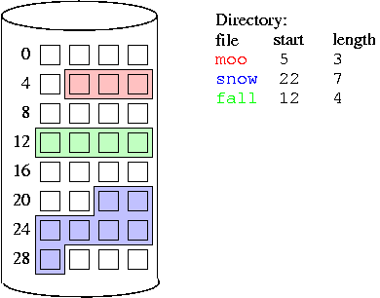
Blocks and Standard (Centralized) File Systems
Single Disk
Disk Block Storage w/ Continuous Blocks
File System Metadata

Slide 9
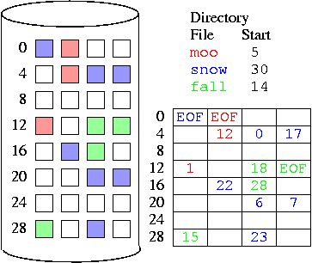
Blocks and Standard (Centralized) File Systems
File System Metadata
Single Disk
Disk Block Storage w/ Discontinuous Blocks

Slide 10
HDFS Concepts
Blocks and the Hadoop Distributed File System
HDFS also stores files as one or more blocks
But these blocks are much larger, generally defaulting to 64Mb to 128Mb or even more
Rather than store the blocks of a file on one disk the blocks are distributed across disks
So HDFS can support files larger than the largest single disk available in the cluster
And file blocks distributed across the cluster can also be read in parallel increasing total I/O throughput

Slide 11
HDFS Concepts
Blocks and the Hadoop Distributed File System
Each file block is usually duplicated twice for a total of three copies (so called default replication factor of 3)
With the two replicas stored on different racks where possible
Replicated blocks are part of the mechanism allowing HDFS high availability and fault-tolerance

Slide 12
HDFS Architecture

Slide 13
HDFS Architecture

Slide 14
HDFS Architecture Blocks and the Hadoop Distributed File System
Client asks for free block space
Data Node 1
Hadoop Cluster
Rack 1
Client
Data Node 1
Block 1
Block 3
Log.txt
150 MB
Block 1
64 MB
Data Node 2
Block 2
Block 3
Data Node 3
Block 1
Block 2
64 MB
Rack 2
Data Node 4
Block 3
22 MB
Block 2
Block 3
Data Node 5
Block 1
Block size = 64Mb
Replication factor = 3
Rack awareness enabled
Data Node 6
Block 2

Slide 15
HDFS Concepts
Block Caching
Normally a data node reads blocks from persistent storage
But frequently accessed blocks may be cached explicitly in memory, for improved data access performance

Slide 16
HDFS Concepts
Name Nodes and Data Nodes
HDFS generalizes two facets of a centralized file system
File storage and file metadata
A HDFS cluster has two categories of nodes operating in a supervisor/worker pattern
One or more Name Nodes (supervisor)
Many Data Nodes (workers)
Name Nodes manage file system metadata
File system directory tree
File system access permissions
File system block location data
Keeps metadata in memory for fast access
Metadata also stored on disk for reliability

Slide 17
HDFS Concepts
Name Nodes and Data Nodes
Name nodes broker access to files by clients
Provides metadata including block location on data nodes
Then client communicate directly with data nodes for files
Data Nodes store and retrieve (and process) file blocks
Blocks are stared as regular files on the local file system
A block itself does not know which file it belongs to
No data node holds more than one replica of any block
Report back to the name node as to what blocks they are holding
Sends a heartbeat message to the name node to say that it is still alive
Racks of data nodes (rack awarness)
Network topology is described to the cluster by an admin
Racks often share local switches and power conditioning units
Can be a single point of failure
If possible no rack holds more than two replicas of a block

Slide 18
Name Nodes and Data Nodes
Hadoop Cluster
Name Node
Rack 1
Data Node 1
Block 1
Block 3
File Metadata
Data Node 2
usr/log.txt
Block 2
Block 1
Block 3
Data Node 1
Data Node 3
Data Node 5
Data Node 2
Data Node 4
Data Node 6
Data Node 1
Data Node 2
Data Node 4
Block 2
Block 3
Data Node 3
Block 1
Rack 2
Data Node 4
Block 2
Block 3
Data Node 5
Block 1
Data Node 6
Block 2

Slide 19
HDFS File Write

Slide 20
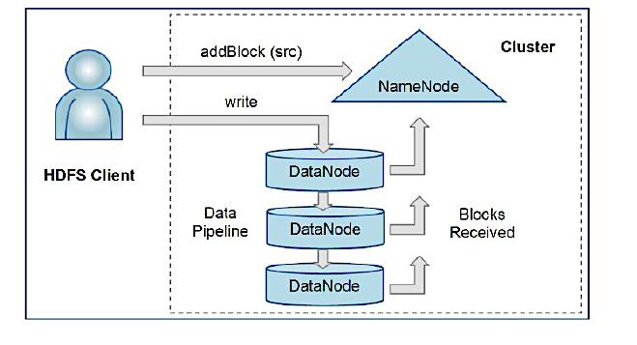
HDFS File Write Block Replication

Slide 21
HDFS File Read

Slide 22
Common HDFS Failures
Node can fail
Software can fail
Disk can crash
Data corruption

Slide 23
Fault Tolerance
How does this architecture achieve high fault-tolerance?
Data Nodes Failure
Name Node Failure

Slide 24
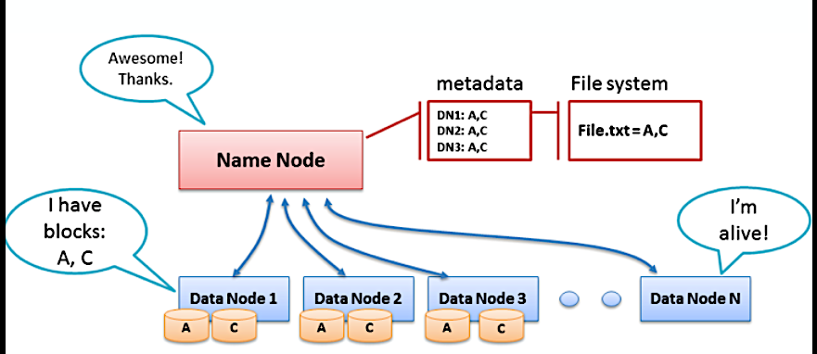
HDFS Architecture Failure Recovery for Data Nodes

Slide 25
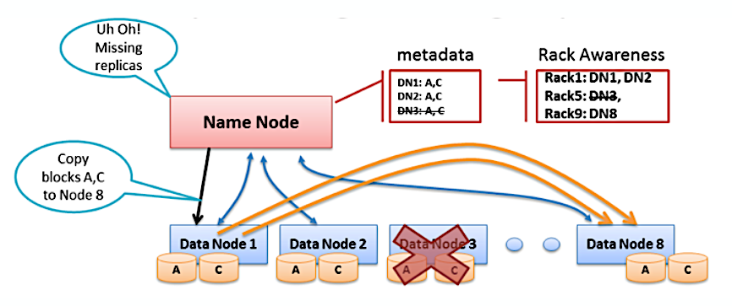
HDFS Architecture Failure Recovery for Data Nodes

Slide 26
Data Node Fault Tolerance
Periodic heartbeat—from data node to name node
Data nodes without recent heartbeat
Marked dead, no new I/O sent
Blocks below replication factor re-replicated to other nodes

Slide 27
Data Corruption Fault Tolerance
Checksum computed on file block creation
Checksums are stored in HDFS metadata
Used to check retrieved data
Re-read from alternate replica if needed

Slide 28
Name Node High Availability (HA)
Phase 0
Single name node maintains all metadata
Single point of failure

Slide 29
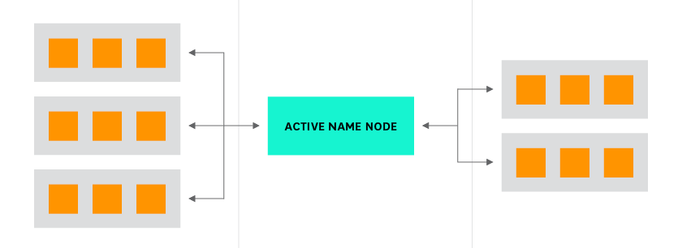
Single Name Node
Rack 1 Rack 2
Active Name Node

Slide 30
How the Name Node Backs Up Metadata
Recall the name node keeps its file metadata in memory but is must be made persistent to survive failures
The name node stores file system metadata in two separate files: fsimage and edit log
These are not stored on HDFS but in the local file system of the Name Node
The fsimage stores a complete snapshot of system metadata at a specific moment in time
Incremental changes are then stored in the edit log for durability
This rather than create a new fsimage snapshot each time the file metadata is modified
The Name Node can restore its state by loading the fsimage and performing all the transformations in the edit log
But this restore operation can take many minutes

Slide 31
Name Node High Availability (HA)
Phase 1
Primary and Secondary Name Node
Communicate using HTTP protocol (no shared storage)
Manual failover to secondary
Avoids planned cluster downtime for primary name node maintenance
Insufficient to protect against unplanned downtime of primary name node

Slide 32
Primary and Secondary Name Nodes
Hadoop Cluster
Block Reports &
Heartbeats
Rack 1
Data Node 1
Block 1
Block 3
Name Node
Data Node 2
Block 2
Block 3
Data Node 3
Block 1
FSImage
Edit Log
(HTTP GET)
Updated
FSImage
(HTTP POST)
Rack 2
Data Node 4
Block 2
Block 3
Secondary Name Node
Data Node 5
Block 1
Data Node 6
Block 2
Block Reports &
Heartbeats

Slide 33
How the Name Node Backs Up Metadata
If present a Secondary Name Node updates the fsimage each time a change is made to the edit log
If the Name Node goes down and is then recovered it does not need to rebuild the fsimage as this was done by the Secondary Name Node
The Secondary Name Node provides two advantages
It unloads the Name Node from the computational burden of updating the fsimage
It also allows a much faster recovery by the Name Node by assuring an up-to-date fsimage is always available

Slide 34
Name Node High Availability (HA)
Phase 2
Automatically detect failure of active name node
Does not require operator intervention to initiate failover
Removes single point of failure

Slide 35
HA Name Node Support
The Name Node and Secondary Name Node do not support automatic failure recovery
The Name Node is still a single point of cluster failure in this arrangement
Moving from a Secondary Name Node to a Standby Name Node provides this availability mechanism
Beyond a Standby Name Node two other system related capabilities are required to support high availability
Shared storage of the fsimage and edit log across name nodes using a highly availability storage scheme
Support to automatically have the Standby Name Node become the (Primary) Name Node using a cluster coordination service

Slide 36
HA Name Node Support
The Quorum Journal Manager to used achieve a high availability metadata filesystem
Reachable by Primary and Standby Name Nodes
Of course, we can’t use HDFS itself… why is this?
When the active name node modifies its metadata it logs a record of change to the majority of journal nodes
The Standby name node watches the journal nodes for changes to the edit logs
And applies them to its local copy of the fsimage

Slide 37
HA Name Node Support
Automatic failover supports requires two components
Zookeeper (Quorum)—used for coordination across cluster nodes
Multiple instances to support HA
ZKFailoverController—a process that runs on each Name Node maintaining contact with Zookeeper
If a Name Node loses contact with Zookeeper the other Name Node becomes aware of this and then takes over as the primary Name Node
The switch over from one name node to another can take just a minute or so
This is much less time than a manual failover to the Secondary Name Node

Slide 38
HA Name Node Support
ZKFC has three simple responsibilities
Monitors health of associated name Nodes
Participates in leader election of Name Nodes
Fences other name nodes if it wins election
Removes requirement for shared name node storage

Slide 39
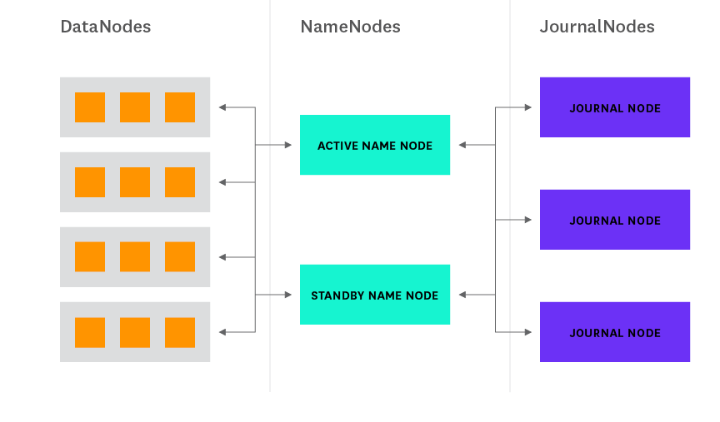
High Availability Configuration
The active name node writes edits to the edit log on journal nodes
Journal Node
Active Name Node
Journal Node
Standby Name Node
Journal Node
The standby name node reads edits from journal nodes and updates
its local FSImage
Data nodes send block reports &
heartbeats to both name nodes
Edits are stored across the
journal node quorum for reliability

Slide 40
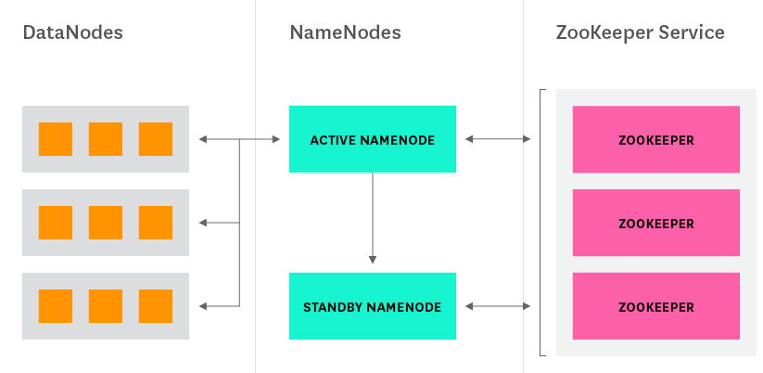
High Availability Configuration
Holds a connection to
Zookeeper while alive
Active Name Node
Standby Name Node
Holds a connection to
Zookeeper while alive
Makes leader selection based
on name node connection status

Slide 41
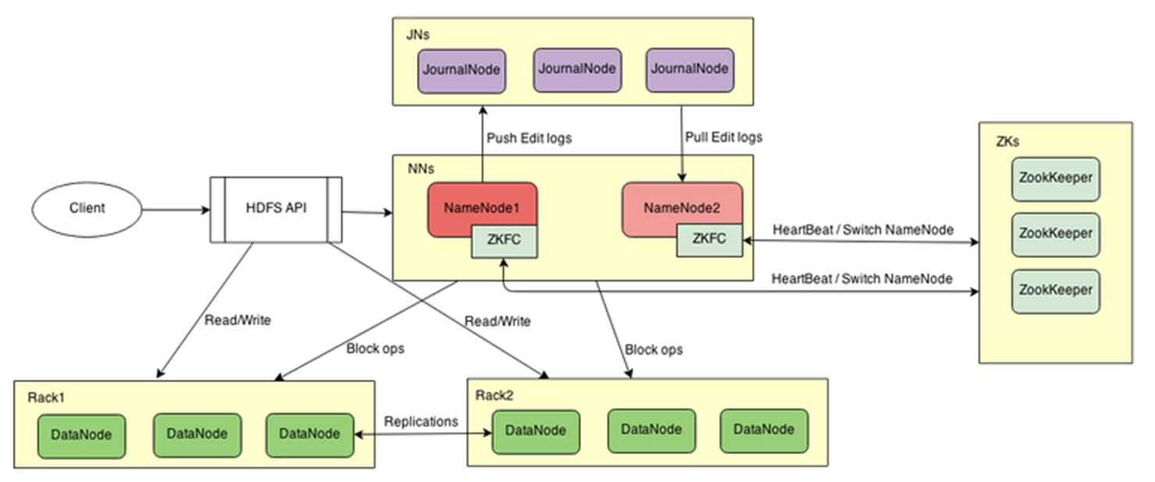
Full HDFS HA Architecture

Slide 42
HDFS Access Options
Via Command Line
Application Programing Interface
NFS Gateway
Other Options

Slide 43
HDFS Command Line
$HADOOP_HOME/bin/hadoop fs <args>
See online command reference
https://hadoop.apache.org/docs/r2.7.2/hadoop-project-dist/hadoop-common/FileSystemShell.html
Also as PDF in “Books” section of the course Blackboard account
Operations are somewhat similar to what you might use to manipulate Linux files and directories
ls, mv, mkdir, chggrp, chgown, cat, cp, …
Some specialized operations for moving data between the local (Linux, Windows) file system and HDFS
copyFromLocal (and put)
copyToLocal (and get)

Slide 44
“hadoop fs” versus “hdfs dfs”
Two command line processors to manipulate Hadoop files
hadoop fs
More “generic” command that allows you to interact with multiple file systems
Local files (linux, windows, etc.)
Simple Storage Service (S3) and other cloud object stores
HDFS (includes EMR, and other cloud hosted Hadoop systems)
hdfs dfs
Command that is specific to the HDFS file system
Note that hdfs dfs and hadoop fs commands become synonymous if the filing system which is used is HDFS

Slide 45
hadoop fs Accessing Different File Systems
File System | Example
HDFS (local) | hdfs:///path/to/local/hdfs//file.json This works on the EMR master node. Amazon EMR resolves paths that do not specify a prefix in the URI to the local HDFS, so the above cold also be written as: /path/to/local/hdfs//file.json
HDFS (remote) | hdfs://name-node-ip-addr:port/path/to/remote/hdfs/file.json
S3 | s3://bucket-name/object_name.json
Local (Linux, etc.) | file:///path/to/local/os/file.json For certain “hadoop fs” commands, you don’t need ‘file://’ when a command argument must be a local file

Slide 46
hadoop fs Accessing Different File Systems
File System | Example
List the contents of an HDFS directory | hadoop fs –ls hdfs:///hdfs-path/dir-name Ex. List the root HDFS directory: hadoop fs –ls / <= ‘hdfs:///’ assumed by default
Create a new HDFS directory | hadoop fs –mkdir hdfs:///hdfs-path/dir-name Ex. Create an HDFS directory ‘joe’ as a sub-directory of the existing HDFS directory ‘/users’: hadoop fs –mkdir /users/joe
Display the contents of an HDFS file or S3 object | hadoop fs –cat s3://bucket-name/object_name.json
Delete an HDFS file or S3 object | hadoop fs –rm hdfs:///hdfs-path/file.json

Slide 47
hadoop fs Accessing Different File Systems
File System | Example
Copy a file from the local file system to the destination file system | hadoop fs –put /usr/local/file.txt hdfs:///hdfs-path/dir-name hadoop fs –put /usr/local/file.txt hdfs:///hdfs-path/file.txt
Copy a file from the local file to HDFS | hadoop fs -copyFromLocal localfile /user/hadoop/hadoopfile
Copy a file from HDFS to the local file system | hadoop fs –get hdfs:///hdfs-path/file.txt /to/path/flie.txt
Display the contents of an HDFS file or S3 object | hadoop fs –cat s3://bucket-name/object_name.json
Delete an HDFS file or S3 object | hadoop fs –rm hdfs:///hdfs-path/file.json

Slide 48
hadoop fs Accessing Different File Systems
File System | Example
Copy a file from source to destination | hadoop fs –cp hdfs:///some/path/to/file.txt hdfs:///other-path Now there are two copies of the file
Move a file from source to destination | hadoop fs –mv hdfs:///some/path/to/file.txt hdfs:///other-path Now there is still one copy of the file, but in a new directory hadoop fs –mv hdfs:///path/file.txt hdfs:///path/renamed.txt Now there is still one copy of the file but with a new name

Slide 49
HDFS Java API
Base Class
org.apache.hadoop.fs.FileSystem
Important Classes
FSDataInputStream
FSDataOutputStream
Operations
get, open, create, read …

Slide 50
HDFS Key Ideas
Write Once, Read Many times (WORM)
Divide files into big blocks and distribute across the cluster
Store multiple replicas of each block for reliability
Programs can ask "where do the pieces of my file live?”

Slide 51
Object Versus HDFS
 | S3 | HDFS
Storage Type | Buckets and Objects No Bucket Hierarchy | Directories and Files Subdirectory Hierarchy
Write Once Read Many | Yes | Yes
Can Update Existing (Stored) Data | No | No
Can Append to Existing (Stored) Data | No | Yes

